Slide 1
Memory Management
Chapter 3

Slide 2
Memory Management
Main memory (RAM) is an important resource that must be very carefully managed. While the average home computer nowadays has 10,000 times more memory than the IBM 7094, the largest computer in the world in the early 1960s,
programs are getting bigger faster than memories. To paraphrase Parkinson’s Law,
‘‘Programs expand to fill the memory available to hold them.’’ In this chapter we will study how operating systems create abstractions from memory and how they manage them.

Slide 3

Basic Memory Management without abstraction (Swapping or Paging)
Three simple ways of organizing memory
- an operating system with one user process

Slide 4
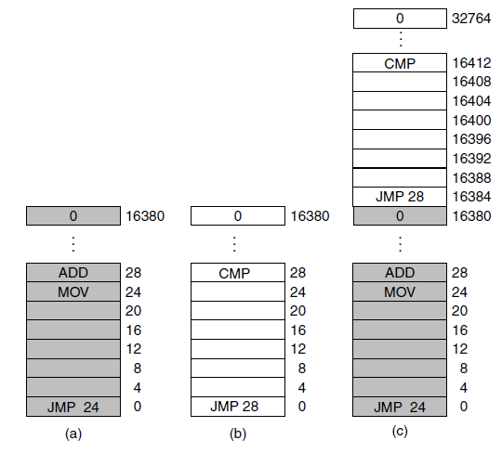
Running Multiple Programs Without a Memory Abstraction
Illustration of the relocation problem. (a) A 16-KB program. (b) Another 16-KB program. (c) The two programs loaded consecutively into memory.

Slide 5
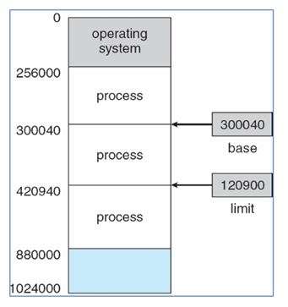
No abstraction
Using Base and Limit registers to separate Address spaces of processes
What is the Base register and what is the Limit register?
• Base register: Specifies the smallest legal physical memory address.
• Limit register: Specifies the size of the range.
• A pair of base and limit registers specifies the logical address space.
• The base and limit registers can be loaded only by the operating system.
Ex: If the base register holds 300040 and the limit register is 120900 then the program can legally access all addresses from 300040 through 420939 (inclusive).
Base and limit registers can be used to give each process a separate address space.

Slide 6
No abstraction - swapping (1)
If the physical memory of the computer is large enough to hold all the processes, the schemes described so far will more or less do. But in practice, the total amount of RAM needed by all the processes is often much more than can fit in memory. On a typical Windows, OS X, or Linux system, something like 50–100 processes or more may be started up as soon as the computer is booted. Consequently, keeping all processes in memory all the time requires a huge amount of memory and cannot be done if there is insufficient memory. Two general approaches to dealing with memory overload have been developed over the years. The simplest strategy, called swapping, consists of bringing in each process in its entirety, running it for a while, then putting it back on the disk. Idle processes are mostly stored on disk, so they do not take up any memory when they are not running (although some of them wake up periodically to do their work, then go to sleep again). The other strategy, called virtual memory, allows programs to run even when they are only partially in main memory.

Slide 7
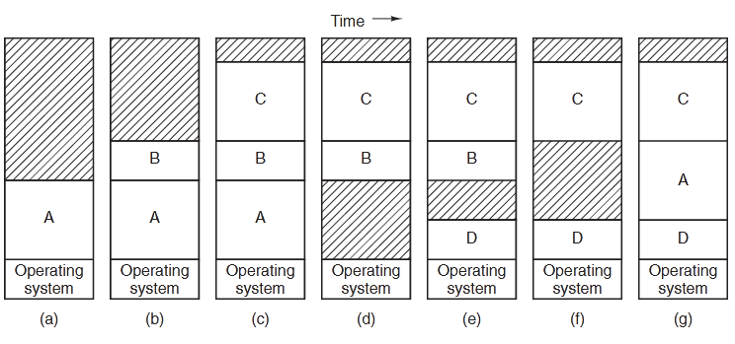
Swapping (2)
The operation of a swapping system is illustrated below. Initially, only process A is in memory. Then processes B and C are created or swapped in from disk. In (d) A is swapped out to disk. Then D comes in and B goes out. Finally A comes in again. Since A is now at a different location, addresses contained in it must be relocated, either by software when it is swapped in or (more likely) by hardware during program execution. For example, base and limit registers would work fine here.

Slide 8
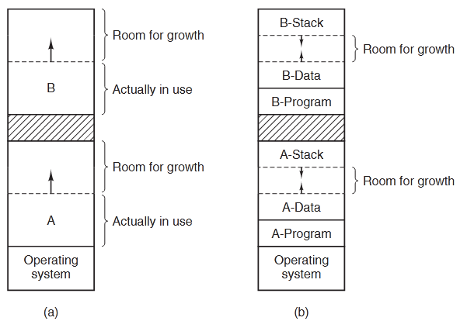
Swapping (3)
If it is expected that most processes will grow as they run, it is probably a good idea to allocate a little extra memory whenever a process is swapped in or moved. When swapping processes to disk, only the memory actually in use should be swapped;
When swapping creates multiple holes in memory, it is possible to combine
them all into one big one by moving all the processes downward as far as possible.
This technique is known as memory compaction. It is usually not done because it requires a lot of CPU time.

Slide 9
Managing Free Memory
When memory is assigned dynamically, the operating system must manage it. In general terms, there are two ways to keep track of memory usage: bitmaps and free lists. In this section and the next one we will look at these two methods.

Slide 10
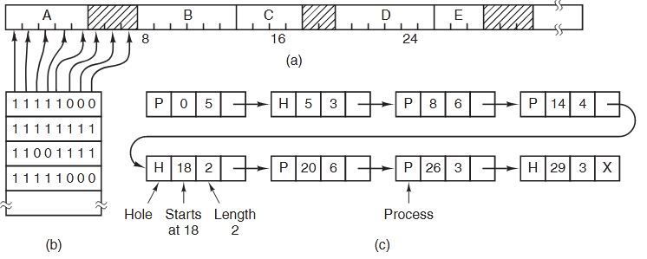
Managing Free Memory with bitmap
With a bitmap, memory is divided into allocation units as small as a few words and as large as several kilobytes. Corresponding to each allocation unit is a bit in the bitmap, which is 0 if the unit is free and 1 if it is occupied (or vice versa).
(a) A part of memory with five processes and three holes. The tick marks show the memory allocation units. The shaded regions (0 in the bitmap) are free. (b) The corresponding bitmap. (c) The same information as a list.

Slide 11
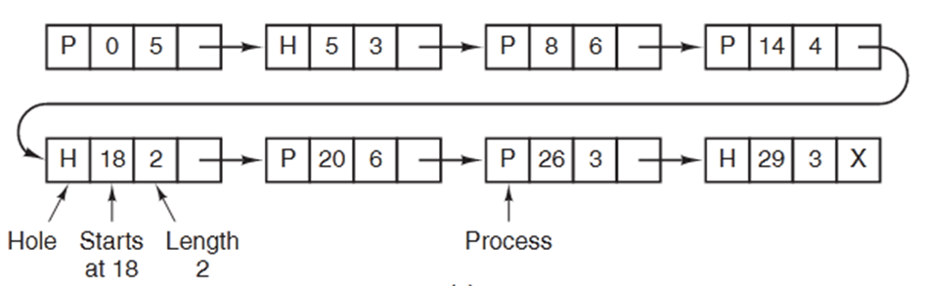
Managing Free Memory with linked list (1)
Another way of keeping track of memory is to maintain a linked list of allo-
cated and free memory segments, where a segment either contains a process or is an empty hole between two processes. The memory can be represented as a linked list of segments. Each entry in the list specifies a hole (H) or
process (P), the address at which it starts, the length, and a pointer to the next item.
In this example, the segment list is kept sorted by address. Sorting this way has the advantage that when a process terminates or is swapped out, updating the list is straightforward.

Slide 12
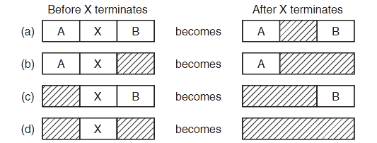
Managing Free Memory with linked list (2)
A terminating process normally has two neighbors (except when it is at the very top or bottom of memory). These may be either processes or holes,
leading to the four combinations shown below, four neighbor combinations for the terminating process X: (a) updating the list requires replacing a P by an H. (b) and (c), two entries are coalesced into one, and the list becomes one entry shorter. (d), three entries are merged and two items are removed from the list.
Since the process table slot for the terminating process will normally point to
the list entry for the process itself, it may be more convenient to have the list as a double-linked list, rather than the single-linked list. This structure makes it easier to find the previous entry and to see if a merge is possible.

Slide 13
Memory Management Algorithms
First-fit: Allocate the first hole that is big enough
Next fit: Start seaching the list from the place where it left off last time
Best-fit: Allocate the smallest hole that is big enough; must search entire list, unless ordered by size
  Produces the smallest leftover hole
Worst-fit: Allocate the largest hole; must also search entire list
  Produces the largest leftover hole
First-fit and best-fit better than worst-fit in terms of speed and storage utilization

